Slide 1
America’s History, Chapter 23

Slide 2
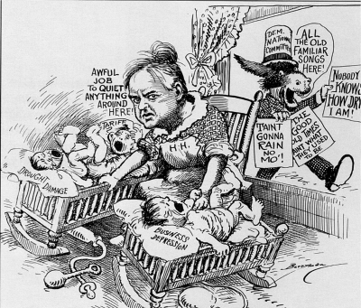
Early Responses to the Depression, 1929 - 1932
Enter Herbert Hoover:
Hoover believed volunteerism and hard work would alleviate the depression
Hoover did not take the US off the gold standard
Smoot-Hawley Tariff - significantly raised tariff rates - retaliatory rates from other countries
Reconstruction Finance Corporation (RFC):
Federal loans to businesses
Spent too little money too cautiously

Slide 3
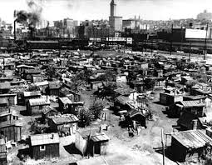
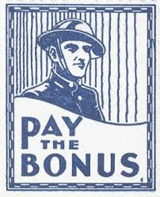
Early Responses to the Depression, 1929 - 1932
Rising Discontent:
Hoovervilles and Hoover blankets
Bonus Army:
15,000 WWI veterans demanded earlier bonus payment
Hoover ordered the army disperse the Bonus Army - popularity decreased significantly

Slide 4
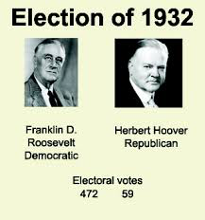
Early Responses to the Depression, 1929 - 1932
The 1932 Election
Hoover v. FDR
FDR defeated Hoover 472 - 59
Unemployment and bank failures continued throughout late 1932 and early 1933

Slide 5
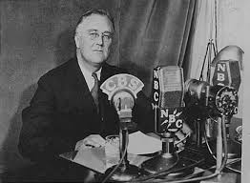
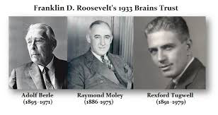
New Deal Arrives, 1933 - 1935
Roosevelt and the First 100 Days:
Fireside chats - Presidential addresses via radio
“Brains Trust” - group of unofficial advisers that helped draft legislation
Frances Perkins - 1st female cabinet member
100 Days - legislation that focused on 4 major areas: banks, agriculture, businesses, and unemployment

Slide 6
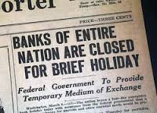
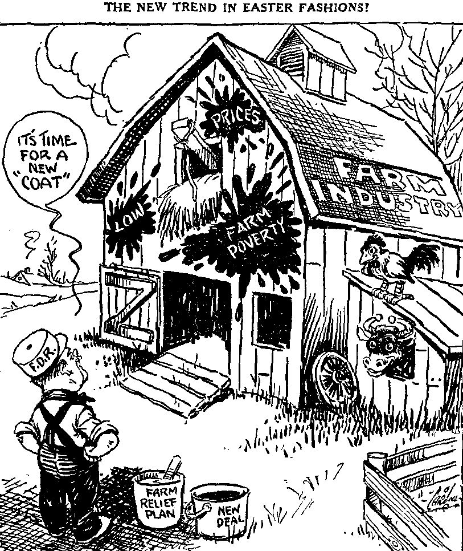
New Deal Arrives, 1933 - 1935
Banking Reform:
Bank Holiday - closing of banks, could not reopen until they proved to be sound (Emergency Banking Act)
Glass-Steagall Act: created FDIC, insured bank deposits up to $2,500
Agriculture and Manufacturing:
Agricultural Adjustment Act (AAA):
Sought to rectify overproduction of farm goods
Paid farmers not to grow crops (benefitted large land owners, not sharecroppers)
National Recovery Administration (NRA):
Industries agreed on prices and production quotas
Both the AAA and NRA were declared unconstitutional by the Supreme Court….

Slide 7
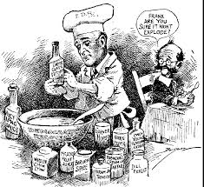
New Deal Arrives, 1933 - 1935
Unemployment Relief:
Federal Emergency Relief Administration (FERA) - provided federal $ to give to states for relief programs
Public Works Administration (PWA):
Construction projects
Civil Works Administration (CWA):
Provided4 million jobs to Americans in the winter of 1933 - 1934
Construction projects - bridges, roads, etc.)
Civilian Conservation Corps (CCC):
Outdoor work, conservation, planting trees, etc.
Mostly young men, 18 - 24, sent $ back home to families

Slide 8
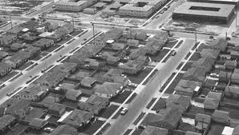
New Deal Arrives, 1933 - 1935
Housing Crisis:
500,000 families lost their homes
Federal Housing Administration (FHA)
Helped regulate interest rates for mortgages

Slide 9
New Deal Arrives, 1933 - 1935
The New Deal Under Attack:
Securities and Exchange Commission (SEC)
Regulated the stock market, sought to prevent abuses
Critics on the Right:
Liberty League - criticized government spending
National Association of Manufacturers:
Used radio and other media to promote their anti-Roosevelt message
Schechter Poultry v. US, and Butler v. US declared the NRA and AAA unconstitutional by the Supreme Court

Slide 10
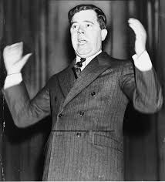
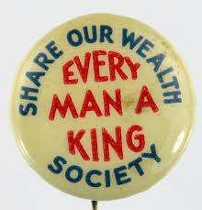
New Deal Arrives, 1933 - 1935
Critics on the Populist Left:
Francis Townsend:
Proposed giving $200 a month to seniors over 60 - helped influence Social Security
Huey Long:
“Share our Wealth”

Slide 11
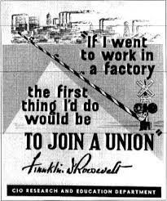
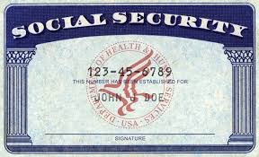
The 2nd New Deal
The Welfare State Comes into Being
1st New Deal - economic recovery, 2nd New Deal - social justice and safety net
The Wagner Act and Social Security:
Since the NRA was declared unconstitutional, unions lost many rights
Wagner Act - workers had the right to join unions, couldn’t be fired for joining union
Social Security Act - provided pensions for retired workers, compensation for unemployed and disabled workers
New Deal Liberalism:
Classical liberalism - associated with free markets

Slide 12
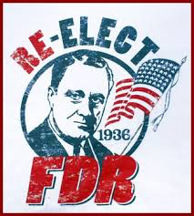
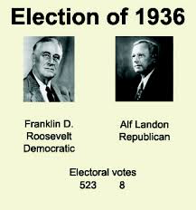
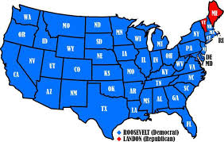
The 2nd New Deal
From Reform to Stalemate
The 1936 Election:
Works Progress Administration (WPA)
Employed over 8 million workers
Construction on roads, bridges, etc.
Republican Alfred Landon challenged FDR, lost election

Slide 13
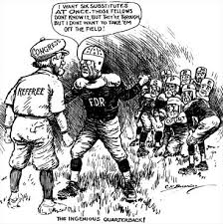
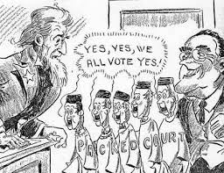
The 2nd New Deal
Court Battle and Economic Recession:
In reaction to the S.C. declaring New Deal Programs unconstitutional, FDR sought to:
Appoint a new justice for every judge over 70 (could appoint 6)
This “court packing plan” was overwhelmingly rejected
“Roosevelt Recession” - FDR cut back on spending due to an improved economy
Keynesian economics - Government must spend $ in a depression to “prime the pump” and stimulate the economy

Slide 14
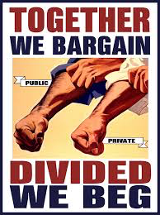
The New Deal’s Impact on Society
A People’s Democracy
Organized Labor:
Union membership increased to 23%
Congress of Industrial Organization (CIO) - organized all workers within an industry regardless of skill level

Slide 15
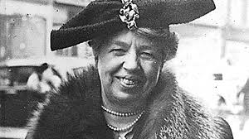
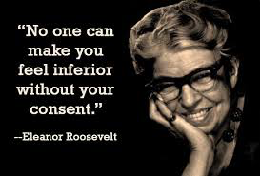
The New Deal’s Impact on Society
Women and the New Deal:
Gender inequities persisted
Elanor Roosevelt:
“Eyes and ears” of FDR, transformed the image of the First Lady
Women were often paid less than men for same jobs
CCC did not allow women to join

Slide 16
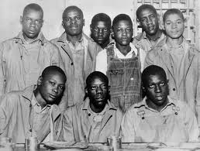
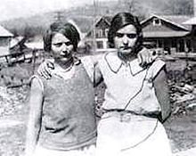
The New Deal’s Impact on Society
African Americans Under the New Deal:
Resettlement Administration - helped small farmers buy land
African Americans began to overwhelmingly vote Democratic
CCC segregated blacks
Lynching persisted throughout the 1900s
Scottsboro Boys - 9 African Americans charged with raping 2 white women on a train, 8 sentenced to death, eventually death sentences were overturned
AAA did not help sharecroppers (checks were given to land owners)

Slide 17
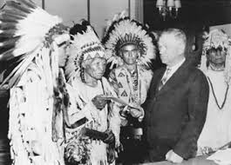
The New Deal’s Impact on Society
Indian Policy:
John Collier - commissioner of Bureau of Indian Affairs (BIA)
Indian Reorganization Act (Indian New Deal):
Reversed the assimilation policy of the Dawes Act
Many Natives were given religious freedom and semi sovereign nation status

Slide 18
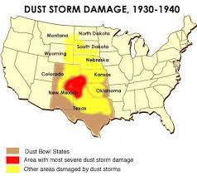
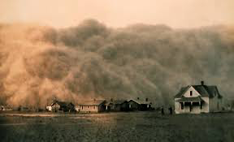
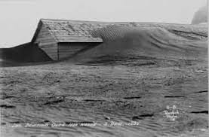
The New Deal’s Impact on Society
Struggles in the West:
Mexican Americans benefitted from the WPA and CCC
Most Chinese were excluded from New Deal Programs
Reshaping the Environment
FDR sought to have land benefit the needs of humans
The Dust Bowl
Impacted mostly the Great Plains region
Over-cultivation affected farmland
“Okies” fled to California - The Grapes of Wrath
Dorothea Lange

Slide 19
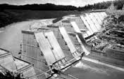
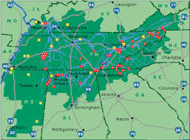
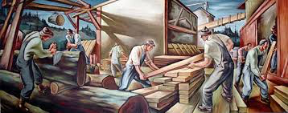
The New Deal’s Impact on Society
Tennessee Valley Authority:
Focused on flood control, electricity development, etc.
Provided a significant amount of electricity to farms, homes, and factories
Rural Electrification Administration:
Provided electricity to rural areas
Grand Coulee
Columbia River, Washington
Largest electricity producer in the world
The New Deal and the Arts
Over 20,000 Artists, musicians, and writers were employed

Slide 20
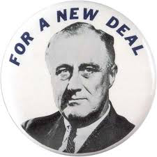
The New Deal’s Impact on Society
Legacies of the New Deal
Millions paid taxes into Social Security
1/3 of the population received government assistance
New Deal was criticized by both the Right and Left
**Change in voting patterns**:
Unions, blacks, and many immigrants predominantly voted Democratic

Slide 21
THE RECAP
Bonus Army
Hoover’s vs. FDR’s response to the Depression
New Deal Programs
Critics of the Great Depression (Right, Left, Supreme Court)
New Deal’s impact on women, African Americans, and Native Americans
TVA
Voting Patterns

